Slide 1
3 – Evaluating technology
UECS3113
Computer Ethics and Professional Responsibility
Oct 2017

Slide 2
Topics covered
Evaluating Information
The “Digital Divide”
Environmental Impacts Of Computing Technology
Making Decisions About Technology
UECS3313-SE-Oct2015

Slide 3
Information, Knowledge, and Judgment
Evaluating Information on the Web:
Expert information or ‘wisdom of the crowd’?
  Daunting amount of information on the web, much of this information is not correct
  Search engines are replacing librarians, but Web sites are ranked by popularity, not by expert evaluation
  Wisdom of the crowd - ratings by public of website
  If millions participate, the results will be useful

Slide 4
Information, Knowledge, and Judgment (cont.)
Evaluating Information on the Web (cont.):
Wikipedia:
  Written by volunteers, some posts are biased and not accurate
  Although anyone can write, most people do not
  Those that do typically are educated and experts

Slide 5
Manipulated / distorted information
post immediately
  no checking of facts.
  personal agendas
search engines ranking
  popularity, not accuracy
blogs and social journalism sites
  no editing to check for validity of content
tools for manipulation of video and audio
  produce videos that are misleading and manipulative
UECS3313-SE-Oct2015

Slide 6
Vulnerable viewers
Young or mentally handicapped people
  Lack ability to analyze arguments and judge material
  argue for regulation / censorship
Preserve freedom of speech
  Provide responses, corrections, alternative viewpoints
  Education from teachers and parents
  Enforcing fraud and libel laws
UECS3313-SE-Oct2015

Slide 7
Ratings and wisdom of the crowd
Online rating systems:
  manipulation of ratings to make something look better
  popularity contests, may not reflect factual truth
Wisdom of the crowd
  crowds can generate good answers to certain kinds of questions
  must have independent, carefully considered opinions
  most common answer is often a good one
UECS3313-SE-Oct2015

Slide 8
Narrowing points of view
get news from a small number of sites
  reflect a specific political/social/cultural/religious point of view.
Academia focuses on online journals
  most quoted articles are here, ignoring older printed versions
Search engines personalize results for users
  helps to filter through the large amount of information on the Web
  may miss out information different to our point of view
UECS3313-SE-Oct2015

Slide 9
Information, Knowledge, and Judgment (cont.)
Evaluating Information on the Web (cont.):
Manipulation of images:
  Movies and videos use special effects to add creativity and enjoyment of entertainment
  People can use technology for deception and fraud
  Ease with which we can modify digital images and video
Should news agencies modify images and videos?
Faking photos is not a new phenomenon; more people can do it now because it’s easy

Slide 10
Writing, Thinking and Deciding
New tools have displaced skills that were once important
Abdicating responsibility
  People willing to let computers do their thinking
  Reliance on computer systems over human judgment may become institutionalized
  Fear of having to defend your own judgement if something goes wrong
Examples:
  DSS-loan approval, symptom checker

Slide 11
Computer models
Collection of data and equations
  simulating characteristics and behavior of a system
  simulate and investigate possible effects of designs, scenarios, and policies
  enable consideration of various alternatives
  project trends and plan better
Example problems studied
  The cost of a proposed government program
  Critical natural resource shortage
  Global warming
  Google maps, Google street view
  Modeling car crashes
  Modeling climate
UECS3313-SE-Oct2015

Slide 12
Computer models
Evaluating Models
  How well do the modelers understand the underlying science or theory?
  Models necessarily involve assumptions and simplifications of reality
  How closely do the results or predictions correspond with the results from physical experiments or real experience?

Slide 13
Computer models - Example
Three models developed to predict health care cost.
U.S adopted Canadian style national health plan and prediction varied $279 billion.
Technical reason for the such difference:
  Might not have complete knowledge
  Description of the data characteristics is incomplete or inaccurate.
  Computing power inadequate for model full complexity of the system.
  It is difficult to numerically quantify variables represent the human values and choices.

Slide 14
Computers and Community
It is human nature to form associations based on common interests.
Some feared early technologies, such as telephones, thinking communication would be de-humanized.
Computers and the Internet were blamed for the decline in community involvement and memberships in clubs and organizations.
The Internet provides communities focused on specialized interests or problems.

Slide 15
Computers and Community (cont.)
The Internet brings people together from all over the world.
E-mail and the Internet provide convenient and cheap ways for families and friends to stay in contact.
New trends include social-networking sites such as Facebook and virtual environments such as Second Life.

Slide 16
The "Digital Divide"
The digital divide refers to the situation where some people have access to modern information technology while others do not.
The digital divide has two fundamentally different dimensions based on Pippa Norris:
  Global divide - refers to the disparity in Internet access between more industrialized and less industrialized nations.
  Social divide - refers to the difference in access between the rich and poor within a particular country.

Slide 17
Global Divide
In 2011, 30 percent of the world population have access to the internet.
Access to the Internet in North America, Oceania/Australia, and Europe was signiﬁcantly above this average while access in Asia and Africa was well below this average.
The cause:
  Often there is little wealth.
  Many of these countries have an inadequate telecommunications infrastructure.
  The primary language is not English.
  Literacy is low, and education is inadequate.
  The country’s culture may not make participating in the Information Age a priority.

Slide 18
Social Divide
the extent to which people use the Internet varies widely according to age, wealth, and educational achievement.

Slide 19
Digital Divide in Malaysia
Implemented by Malaysian Communications And Multimedia Commission (MCMC)
  Internet users in Malaysia (18.6 million or 63.6%).
  National Broadband Initiative (NBI) - broadband penetration of 75 per cent by 2015
  community broadband centers across the country and distributing netbooks
  94.3% are Malaysian and 5.7% are other nationalities.
UECS3313-SE-Oct2015

Slide 20
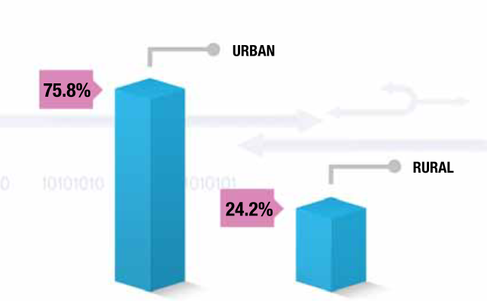
Digital Divide in Malaysia
Internet users in rural areas.
UECS3313-SE-Oct2015

Slide 21
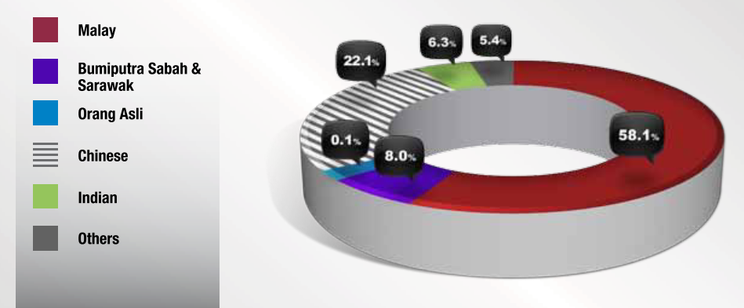
Digital Divide in Malaysia
Internet users based on ethnic.
UECS3313-SE-Oct2015

Slide 22
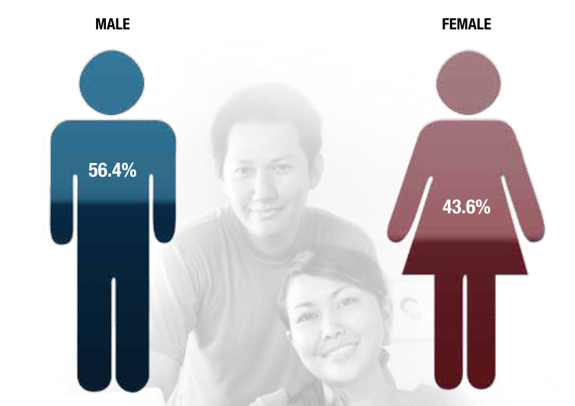
Digital Divide in Malaysia
Internet users based on gender.
UECS3313-SE-Oct2015

Slide 23
EFFORTS TO SHRINK THE DIGITAL DIVIDE IN MALAYSIA
Various major efforts have been made by several parties – state governments, giant national corporations and multi-national companies. The following describe some of these efforts:
UECS3313-SE-Oct2015

Slide 24
The "Digital Divide"
Trends in Computer Access:
New technologies only available to the wealthy
The time it takes for new technology to make its way into common use is decreasing
Cost is not the only factor; ease of use plays a role
Entrepreneurs provide low cost options for people who cannot otherwise afford something
Government funds technology in schools
As technology becomes more prevalent, the issues shift from the haves and have-nots to level of service

Slide 25
e-Bario (Year 2001)
e-Bario is a project that utilises computers, telephones and VSATs to connect villagers in the remote areas to the Internet. This project was designed to bridge the gap between the shy and unexposed students in the village of Bario and their aggressive, well-informed counterparts in larger cities. Villagers were introduced to computers and this has helped both to improve information flows to and from the outside world and to better their socio-economic position.
UECS3313-SE-Oct2015

Slide 26
e-Melaka (Year 2003)
The Melaka state government launched its Closing the Digital Divide project in 2003. In this scheme, cyber cafes were used as training centres to teach the rural public ICT literacy. Busloads of rural citizens were brought to the cyber cafés and for every course participant, the state government paid the cyber café owner RM5 per hour. By the end of 2004, the scheme had managed to train 25,000 participants.
UECS3313-SE-Oct2015

Slide 27
The Mobile Internet Unit (2004)
In the state of Selangor, with a US$75, 000 grant from UNDP and donations from DRB-Hicom, MIMOS and Hup Lee Coachbuilders Sdn Bhd, the Mobile Internet Unit was launched.
The project consisted of three buses equipped with 20pcs with visits made to 20 schools that were without computer facilities in central Selangor, while two smaller ones, with 12 computers each visited 20 schools in the capital. It is reported that 2,400 students and 400 teachers have benefited from this programme.
UECS3313-SE-Oct2015

Slide 28
Cyber Café (2004)
In Tumpat, a fishing village in the state of Kelantan, cyber cafés have been established to bridge the digital gap. Two of these cafés are located in the town centre, three in the rural area and two more operate in the villages. These cafés are frequented by school students, teenagers and older villagers.
UECS3313-SE-Oct2015

Slide 29
Jejak-IT (Year 2005)
In 2005, the Jejal-IT centre offers IT related e-books and dozens of affordable learning packages with different levels of understanding in IT. An interested user can subscribe and make payment online to a learning package that he/she is interested in and the lesson begins. This is a very convenient arrangement especially for those in remote areas and also for those who are not able to be physically present at formal IT classes.
UECS3313-SE-Oct2015

Slide 30
Evaluations of the Impact of Computer Technology
The Neo-Luddite View of Computers, Technology, and Human Needs:
Computers cause massive unemployment
No real need (We use technologies because they are there, not because they satisfy real needs)
Computers cause social inequity
Benefit big business and the government
Do little or nothing to solve real problems
Computers separate humans from nature and destroy the environment

Slide 31
Evaluations of the Impact of Computer Technology
Accomplishments of Technology:
Prices of food are down and raw materials are abundant
Real buying power is up
Food supplies and GDP are growing faster than the population
Dramatic impact on life expectancy
Assistive technologies benefit those with disabilities

Slide 32
Impact on environment
Negative impacts:
  Production is energy intensive and uses hazardous materials
  Running and cooling millions of servers uses a lot of electricity
Positive impacts:
  Digitally controlled machinery uses less power
  Sensors for regulating heating, air conditioning, etc save resources
  Telecommuting, e—commerce reduce need for transportation and fuel
  Digital storage of documents and email, texting, reduce the need for paper
UECS3313-SE-Oct2015

Slide 33
Artificial Intelligence(AI)
AI - “a ﬁeld of computer science and engineering concerned with the computational understanding of what is commonly called intelligent behavior, and with the creation of artifacts that exhibit such behavior”.
Radically change human civilization
Risk of superintelligent machines
  eventually replacing the human race
  Robots as “programmable machines that either in performance or appearance imitate human activities”
UECS3313-SE-Oct2015

Slide 34
Response to AI threats
Anticipate problems and design protections
  protections might be based on the same technologies of the AI machines
Limit development of the technologies that are too dangerous
  Difficult to enforce this in a free market economy
  Difficult to know where to draw the line between useful and dangerous technologies
  resulting in loss of potentially beneficial technologies
UECS3313-SE-Oct2013

